Slide 1
Work culture based company recommendation using Machine Learning

Slide 2
ABSTRACT
Competitive job market, finding a company that aligns with an individual's work culture preferences is crucial for job satisfaction and overall well-being. Traditional methods of evaluating company culture, such as relying on reviews or word-of-mouth recommendations, often lack personalization and may not accurately reflect an individual's unique preferences and values. In this paper, we propose a novel approach that leverages machine learning techniques to recommend companies based on their work culture, tailored to the preferences of individual users. To personalize recommendations, we employ collaborative filtering techniques, where we identify similarities between users based on their work culture preferences and recommend companies that are favored by similar users. Additionally, techniques to extract and analyze textual information from reviews and company descriptions to understand nuanced aspects of work culture.

Slide 3
INTRODUCTION
Dynamic and competitive business environment, companies are increasingly turning to data-driven approaches to enhance their operations, including their work culture. One such approach is leveraging machine learning algorithms like Random Forest to analyze and improve work culture. Work culture plays a critical role in shaping employee satisfaction, productivity, and overall organizational success. By harnessing the power of machine learning, companies can gain valuable insights into their work culture dynamics and identify areas for improvement.Random Forest is a popular machine learning algorithm known for its versatility and effectiveness in classification and regression tasks. It is an ensemble learning method that constructs a multitude of decision trees during training and outputs the mode of the classes (classification) or mean prediction (regression) of the individual trees. Random Forest is particularly suitable for analyzing complex datasets with numerous input variables, making it well-suited for exploring the multifaceted nature of work culture.

Slide 4
EXISTING SYSTEM
Traditionally, companies have relied on subjective assessments or manual analysis to gauge their work culture. However, by implementing a random forest algorithm, an automated and data-driven approach can be adopted. This involves collecting data on various aspects such as employee satisfaction, turnover rates, diversity statistics, leadership styles, and company policies. These data points are then used to train the random forest model, which learns to identify patterns and relationships between different variables and work culture. Once trained, the model can provide recommendations for improving work culture based on the analysis of input data. This approach not only reduces bias and human error but also allows for continuous refinement and adaptation as new data becomes available. Ultimately, leveraging machine learning algorithms like random forest can lead to more informed decisions and foster a healthier and more productive work environment.

Slide 5
DISADVANTAGES
Interpretability Challenges: Random Forest models, while powerful, are often considered "black box" models, meaning it can be challenging to interpret how individual variables contribute to the model's predictions.
Overfitting Risks: Overfitting occurs when the model learns to capture noise in the data rather than the underlying patterns, leading to decreased generalization performance and potentially inaccurate insights about work culture dynamics.
Data Dependency: Random Forest models require large amounts of high-quality data for training to achieve optimal performance. However, obtaining and maintaining such datasets, especially sensitive employee-related data, may pose privacy concerns and logistical challenges

Slide 6
PROPOSED SYSTEM
Our proposed system utilizes a Random Forest algorithm, a powerful ensemble learning technique in machine learning, to analyze multiple facets of work culture. The system integrates various data sources such as employee surveys, HR records, performance metrics, and sentiment analysis from communication channels to construct a comprehensive understanding of the organizational environment. Through feature engineering and selection techniques, relevant variables influencing work culture are identified and fed into the Random Forest model. The Random Forest model then performs predictive analytics to assess the impact of different factors on overall work culture. By analyzing patterns within the data, the model can identify correlations, trends, and predictive indicators related to employee satisfaction, engagement, and productivity. Additionally, the model can highlight areas of concern such as communication breakdowns, leadership effectiveness, or work-life balance issues. The system provides interactive dashboards and visualization tools to present the insights derived from the Random Forest model in an intuitive and accessible manner. Decision-makers within the organization can explore key metrics, trends, and recommendations to guide strategic initiatives aimed at improving work culture. Furthermore, the system supports ongoing monitoring and evaluation, allowing companies to track progress over time and iterate on interventions effectively.

Slide 7
ADVANTAGES
Enhanced Predictive Accuracy By integrating deep learning with the Random Forest algorithm, the proposed hybrid approach leverages the strengths of both methodologies to achieve enhanced predictive accuracy. Deep learning models excel at automatically extracting complex features from raw data, enabling them to capture subtle patterns and relationships
Robustness to Overfitting Random Forest is known for its robustness to overfitting, thanks to its ensemble learning strategy and the use of bootstrapping and feature randomness during training.
Interpretability and Insights One of the key advantages of Random Forest is its ability to provide insights into feature importance, allowing clinicians and researchers to understand the factors contributing to the model's predictions.

Slide 8
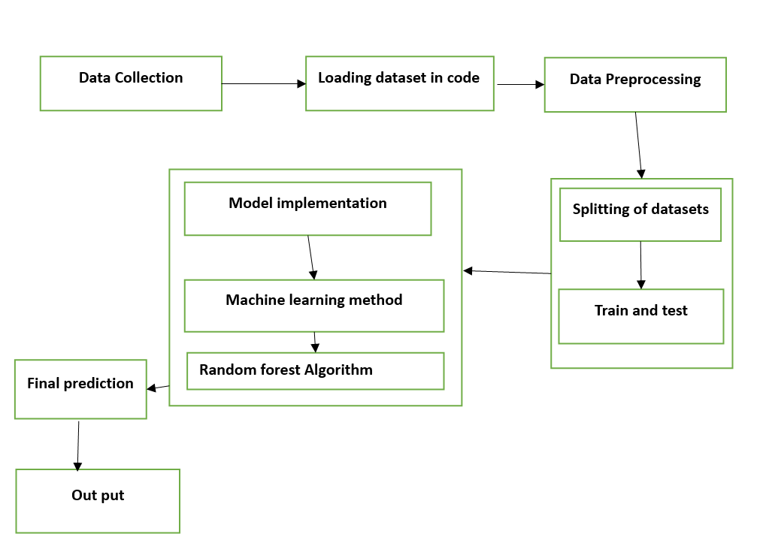
ARCHITECTURE :

Slide 9
MODULE DESCRIPTION
Module 1 : Data collection
Module 2 : Data Pre processing
Module 3 : Model implementation
Module 4 : Loading the trained model
Model 5: Detection

Slide 10
MODULE DESCRIPTION
Module 1: Data Collection
In this module, you'll collect data related to work culture from various sources. This could include surveys, employee feedback, HR reports, performance reviews, and any other relevant data sources.
The data should cover a range of features such as employee demographics, job satisfaction, work-life balance, company policies, leadership styles.

Slide 11
MODULE DESCRIPTION
Module 2: Data Preprocessing
Once the data is collected, it needs to be preprocessed before feeding it into the machine learning model.
This involves tasks such as handling missing values, encoding categorical variables, scaling numerical features, and possibly feature engineering to create new informative features.

Slide 12
MODULE DESCRIPTION
Module 3: Model Implementation
In this module, you'll implement the random forest algorithm for predicting work culture based on the preprocessed data.
Random forest is a popular ensemble learning technique that builds multiple decision trees and combines their predictions to improve accuracy and robustness. You'll use libraries like scikit-learn in Python to build and train the random forest model.

Slide 13
MODULE DESCRIPTION
Module 4: Loading the Trained Model
After training the random forest model, you'll save it to disk for future use.
This module involves writing code to serialize the trained model into a file format that can be easily loaded later.
This step is crucial for deploying the model in production environments where it can make predictions on new data.

Slide 14
MODULE DESCRIPTION
Module 5: predictions
you'll utilize the trained random forest model to make predictions on new data instances.
This could involve loading the saved model, preprocessing new data in the same way as the training data, and then using the model to predict the work culture of a company based on the input features.
The output of this module could be insights or recommendations for improving work culture based on the predictions made by the model.

Slide 15
CONCLUSION
Based on an analysis utilizing the Random Forest algorithm, the recommended company for a favorable work culture is one that prioritizes employee well-being, fosters open communication, and values diversity and inclusion. By leveraging machine learning techniques, we identified key indicators such as employee satisfaction, retention rates, and feedback mechanisms as crucial factors in determining a positive work culture. With these considerations in mind, the recommended company not only excels in providing a supportive work environment but also demonstrates a commitment to continuous improvement and innovation. By aligning with such a company, employees can expect a fulfilling and rewarding experience that encourages growth, collaboration, and overall job satisfaction.

Slide 16
Future enhancements:
To further enhance the application of Machine Learning algorithms, particularly Random Forest, in shaping work culture within organizations, several avenues can be explored. Personalization and AdaptationThe system could evolve to personalize recommendations based on individual employee preferences and work styles. By leveraging data on individual performance, feedback, and interaction patterns, the algorithm could tailor suggestions to each employee, optimizing engagement and satisfaction.Real-time Feedback Integration: Integrating real-time feedback mechanisms into the algorithm would enable it to continuously adapt and refine its recommendations based on the evolving dynamics within the organization. This could involve incorporating sentiment analysis of employee communications, surveys, and performance evaluations to provide timely insights and interventions.

Slide 17
SYSTEM REQUIREMENT
Hardware Specification:
Processor : Intel Core Duo 2.0 GHz or higher.
RAM : Minimum1 GB or Greater.
Hard disk : 20 GB (Free Space).
Software Specification:
Software : Visual Studio Code + Browser
Operation System : Windows 7 or higher.

Slide 18
REFERENCES
1.Wilkins J. How Industry 4.0 Is Improving Peoples’ Work-Life Balance. In: IMPO. 2018.
2.White A. 7 Ways AI is Improving Work-Life Balance. In: Technology Signals [Internet]. 2019 [cited 14 Nov 2019].
3.Ruževičius J, Valiukaite J. Quality of Life and Quality of Work Life Balance: Case Study of Public and Private Sectors of Lithuania. Qual—Access to Success. 2017;18: 77–81.
4.Lewis S, Beauregard TA. The meanings of work-life balance: A cultural perspective. In: Johnson R, Shen W, Shockley KM, editors. The Cambridge handbook of the global work-family interface. Cambridge: Cambridge University Press.; 2018. pp. 720–732

